Slide 1

Vidyavardhini's College of Engineering & Technology
Department of Computer Engineering
(A.Y. 2023-24)

Slide 2
IPL Win Probability Predictor using Logistic Regression
by
Mohit Raje (Roll No. 33) Pranit Patil (Roll No.32)
Pranav Maurya (Roll No.29)
Parth Gharat (Roll No.23)
Mentor
Dr. Megha Trivedi

Slide 3
Introduction:
The Indian Premier League (IPL) is the pinnacle of T20 cricket, where each ball can alter a match's course.
Our project, "IPL Win Probability Predictor Using Logistic Regression," addresses this challenge.
We leverage cutting-edge predictive analytics and logistic regression, a powerful binary classification model, to create a robust tool for estimating IPL match win probabilities.
The IPL's T20 format involves multiple variables, including team composition, player statistics, pitch conditions, and coin toss outcomes.
The IPL Win Probability Predictor, driven by logistic regression, turns this data complexity into real-time insights, enhancing match outcome predictions.

Slide 4
Problem Statement
The Indian Premier League (IPL) is a dynamic and unpredictable T20 cricket competition. The problem at hand is to develop an IPL Win Probability Predictor using logistic regression, which accurately estimates the likelihood of each team's victory in real-time during IPL matches.
This involves collecting and preprocessing diverse match-related data, implementing logistic regression for prediction, and delivering an intuitive user interface to enhance the cricket-watching experience.

Slide 5
Objectives :
Real-Time Prediction Engine
User-Friendly Interface
Data Collection and Preparation
Accurate Predictions
Interactive Match Insights

Slide 6
Survey of Existing System
IPL Win Probability Prediction: In the realm of sports analytics, the Indian Premier League (IPL) Win Probability Predictor is gaining prominence. Existing systems use statistical and machine learning techniques, primarily logistic regression, to predict match outcomes. They analyze various data, including team performance, player stats, pitch conditions, and head-to-head records, using logistic regression to estimate win probabilities. Real-time data feeds are incorporated for dynamic model updates during matches.
Challenges Faced: T20 cricket's dynamic and unpredictable nature poses challenges. Advanced machine learning techniques like ensemble methods and deep learning are used to improve accuracy. Additionally, relying solely on historical data may lead to model stagnation. Some systems employ transfer learning and adaptive modeling to account for evolving team dynamics and player performances.

Slide 7
Limitations and Research Gaps
Real-Time Variables: Existing systems rely heavily on historical data and often fail to consider real-time factors such as player injuries, form fluctuations, and tactical decisions. There's a research gap in developing dynamic models that can adapt to these real-time variables, thus enhancing prediction accuracy.
Complexities of T20 Cricket: While logistic regression is simple, it may not capture the complexities of T20 cricket. Research opportunities exist in integrating more sophisticated machine learning techniques, like deep learning and reinforcement learning, to better model the game's intricate nuances. This could enable predicting critical turning points within a match and adjusting win probability estimates accordingly.
Advancing IPL Win Probability Prediction: Addressing these limitations and research gaps is crucial for advancing IPL Win Probability Prediction, making it more practical for cricket fans, coaches, and sports analysts.

Slide 8
Proposed System
Binary Classification: Logistic regression is employed to classify the outcome of IPL matches into two categories: "win" or "lose." It's used to predict whether a specific team will win or lose a match.
Model Training: Historical IPL match data, including features like team performance, player statistics, and match conditions, is used to train the logistic regression model. The model learns the relationships between these features and match outcomes.
Probability Prediction: The logistic regression model predicts the probability of a team winning or losing a match based on the input data. It provides a probability score for each category.

Slide 9
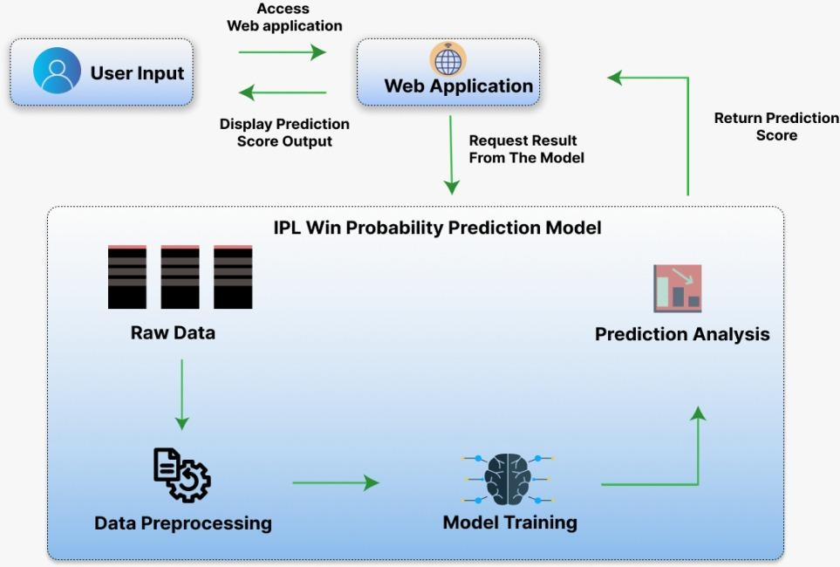
Architecture/Framework/Block Diagram

Slide 10
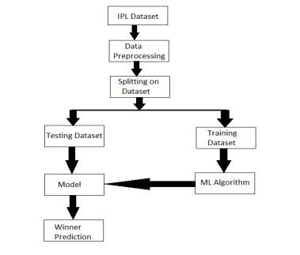
Model Diagram

Slide 11
Details of Hardware & Software
Hardware:
Intel Processor
8 GB RAM
Software:
streamlit
pandas
numpy
sklearn

Slide 12
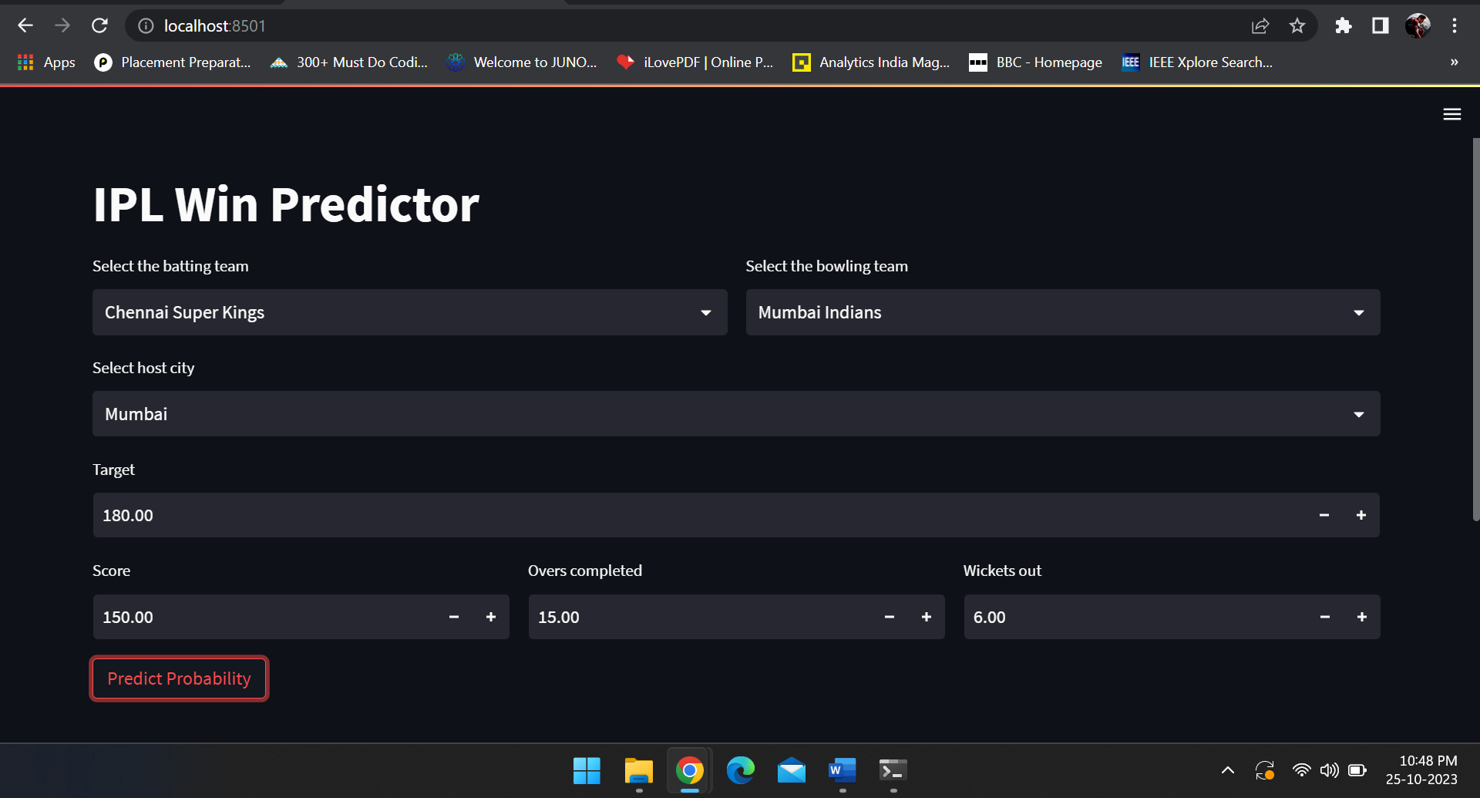
Experiment and Results for Validation and Verification

Slide 13
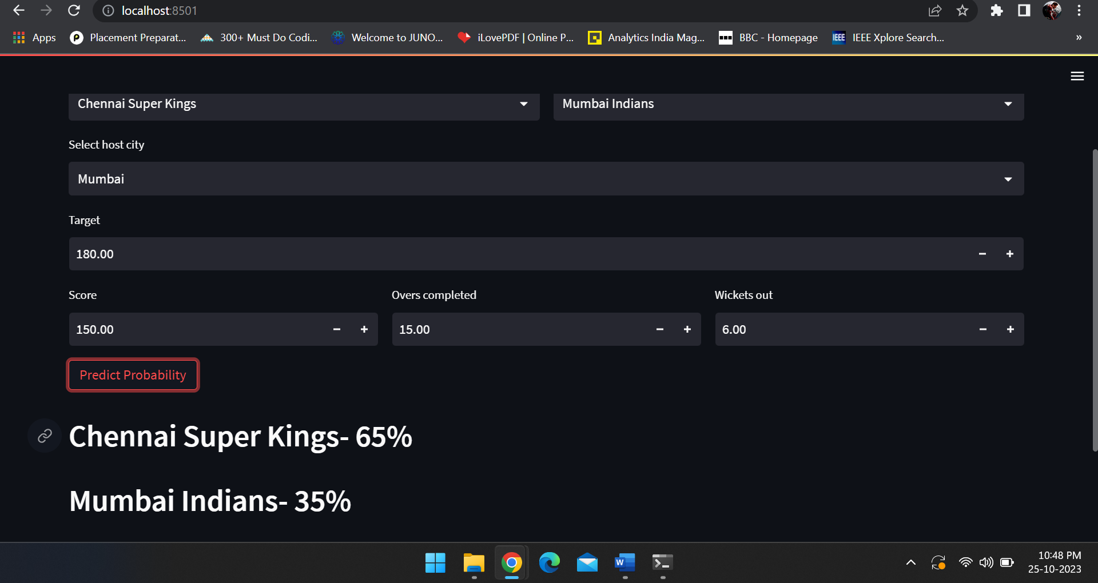

Slide 14
Conclusion
In conclusion, building an IPL match winner predictor using logistic regression is a complex task that involves multiple steps in data preparation, model creation, and evaluation. While logistic regression is a suitable choice for binary classification tasks like predicting the winning team (Team A or Team B) in an IPL match.Ultimately, an IPL win predictor using logistic regression can serve as a valuable exercise in data analysis and machine learning, offering insights into the factors that influence match outcomes in the IPL. However, it's essential to acknowledge the inherent unpredictability of sports and consider this model as one tool among others for understanding and analyzing cricket match results.

Slide 15
Thank you

